Slide 1
Global open science hardware: an introduction
Kaspar Emanuel, Juanma Garcia, Naiane R Rios

Slide 2
Why open hardware?
How to make hardware open
Global Open Science Hardware Community
What can you do?

Slide 3

Science
requires TOOLS
a
black box
proprietary
hard to
maintain
difficult
to source
difficult to customise

Slide 4
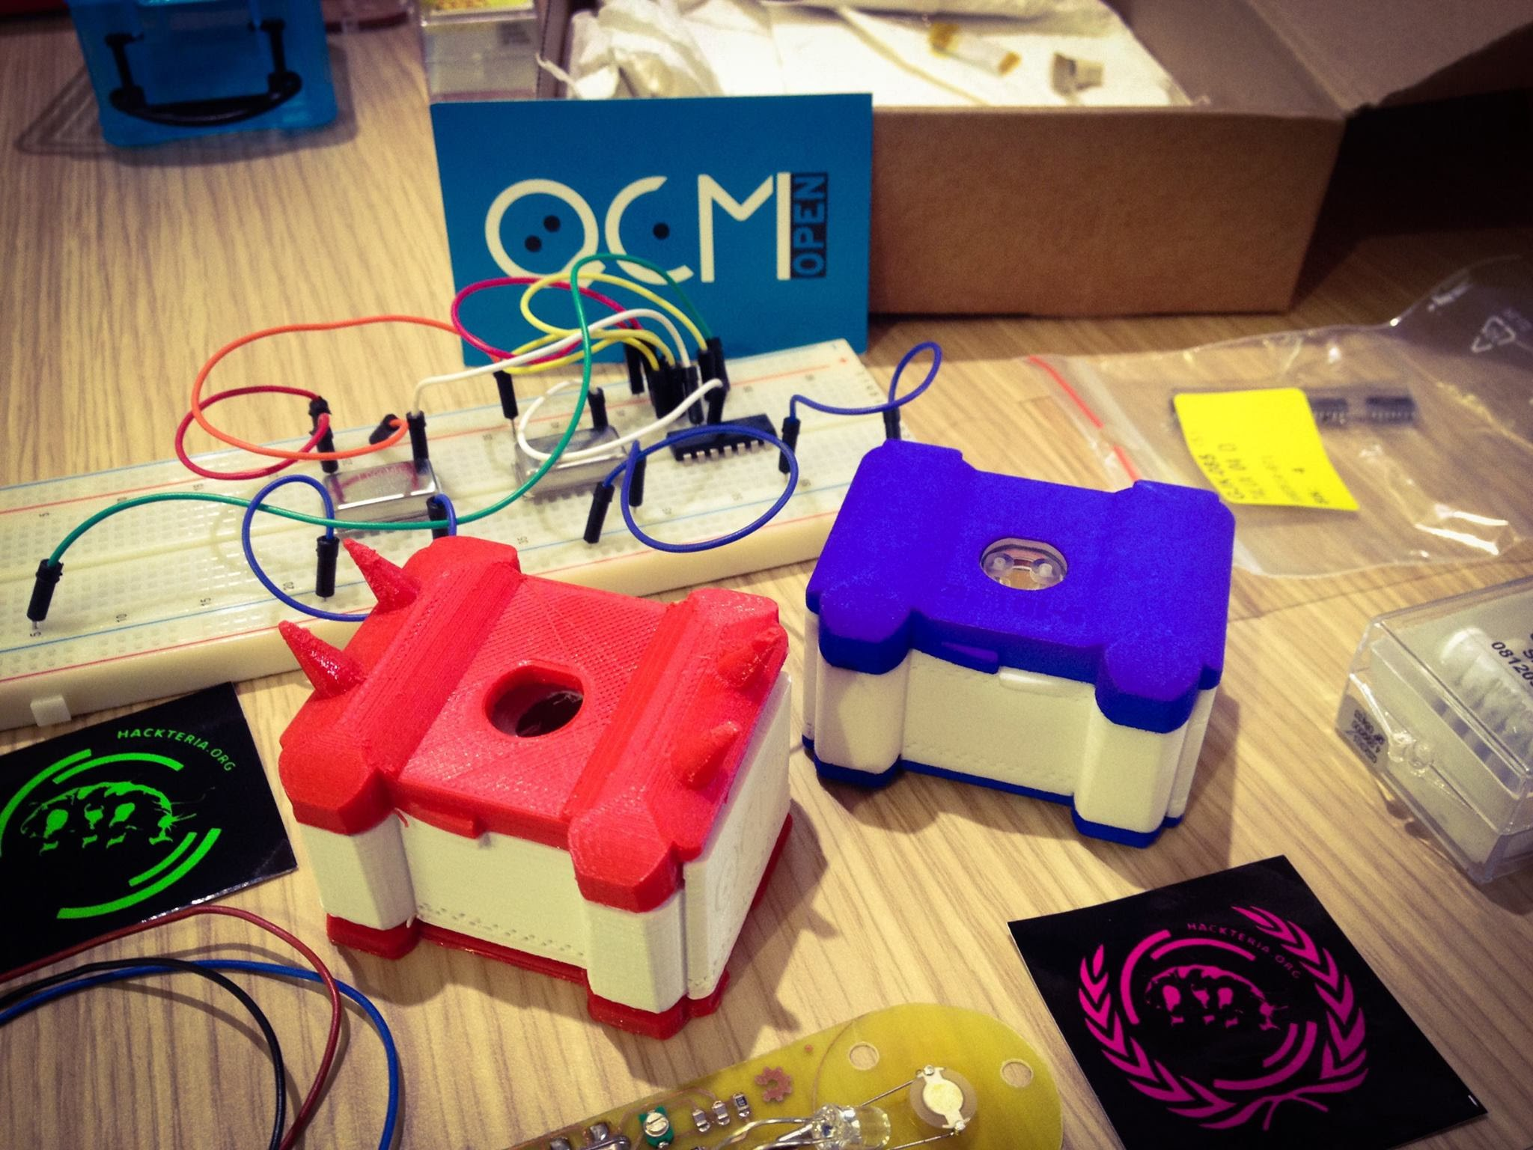
Makers make tools
easier to maintain
open-source
easy to customise
Openly documented
manufactured hyper-locally

Slide 5
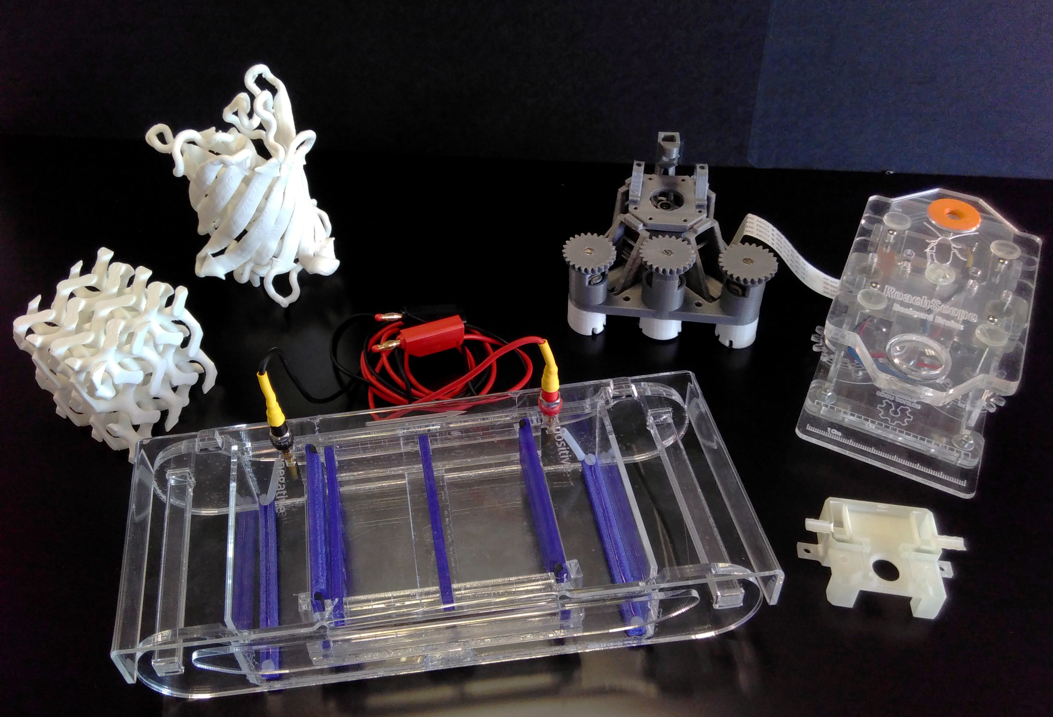
There are lots out there...

Slide 6
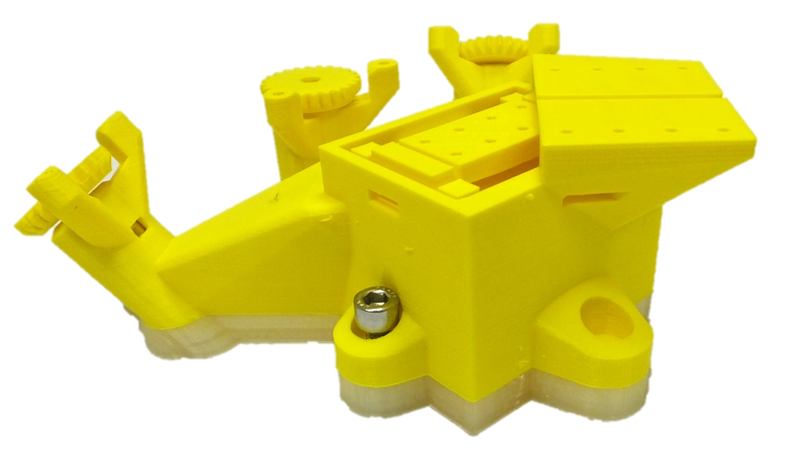
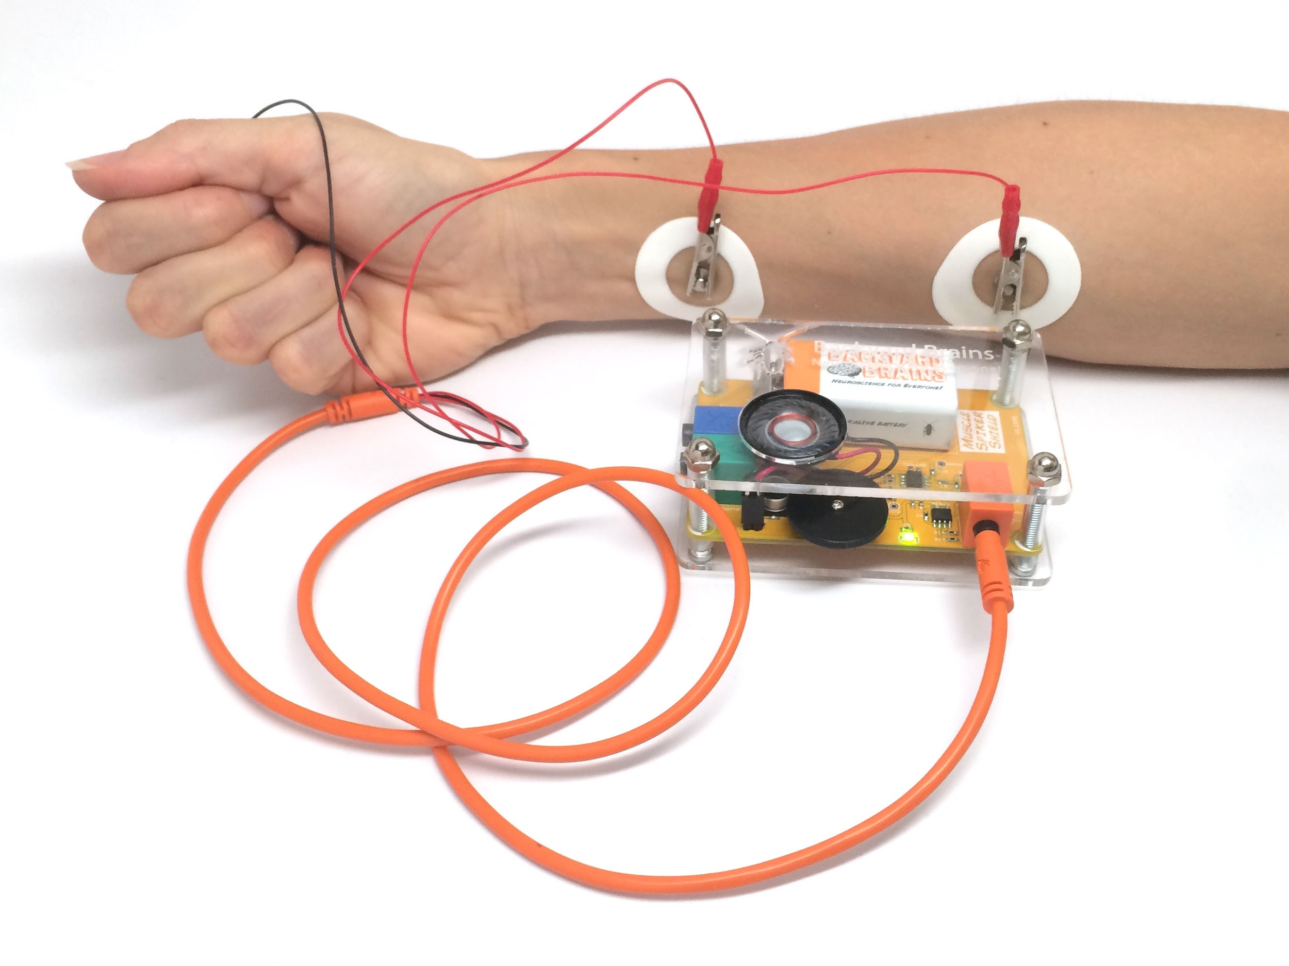
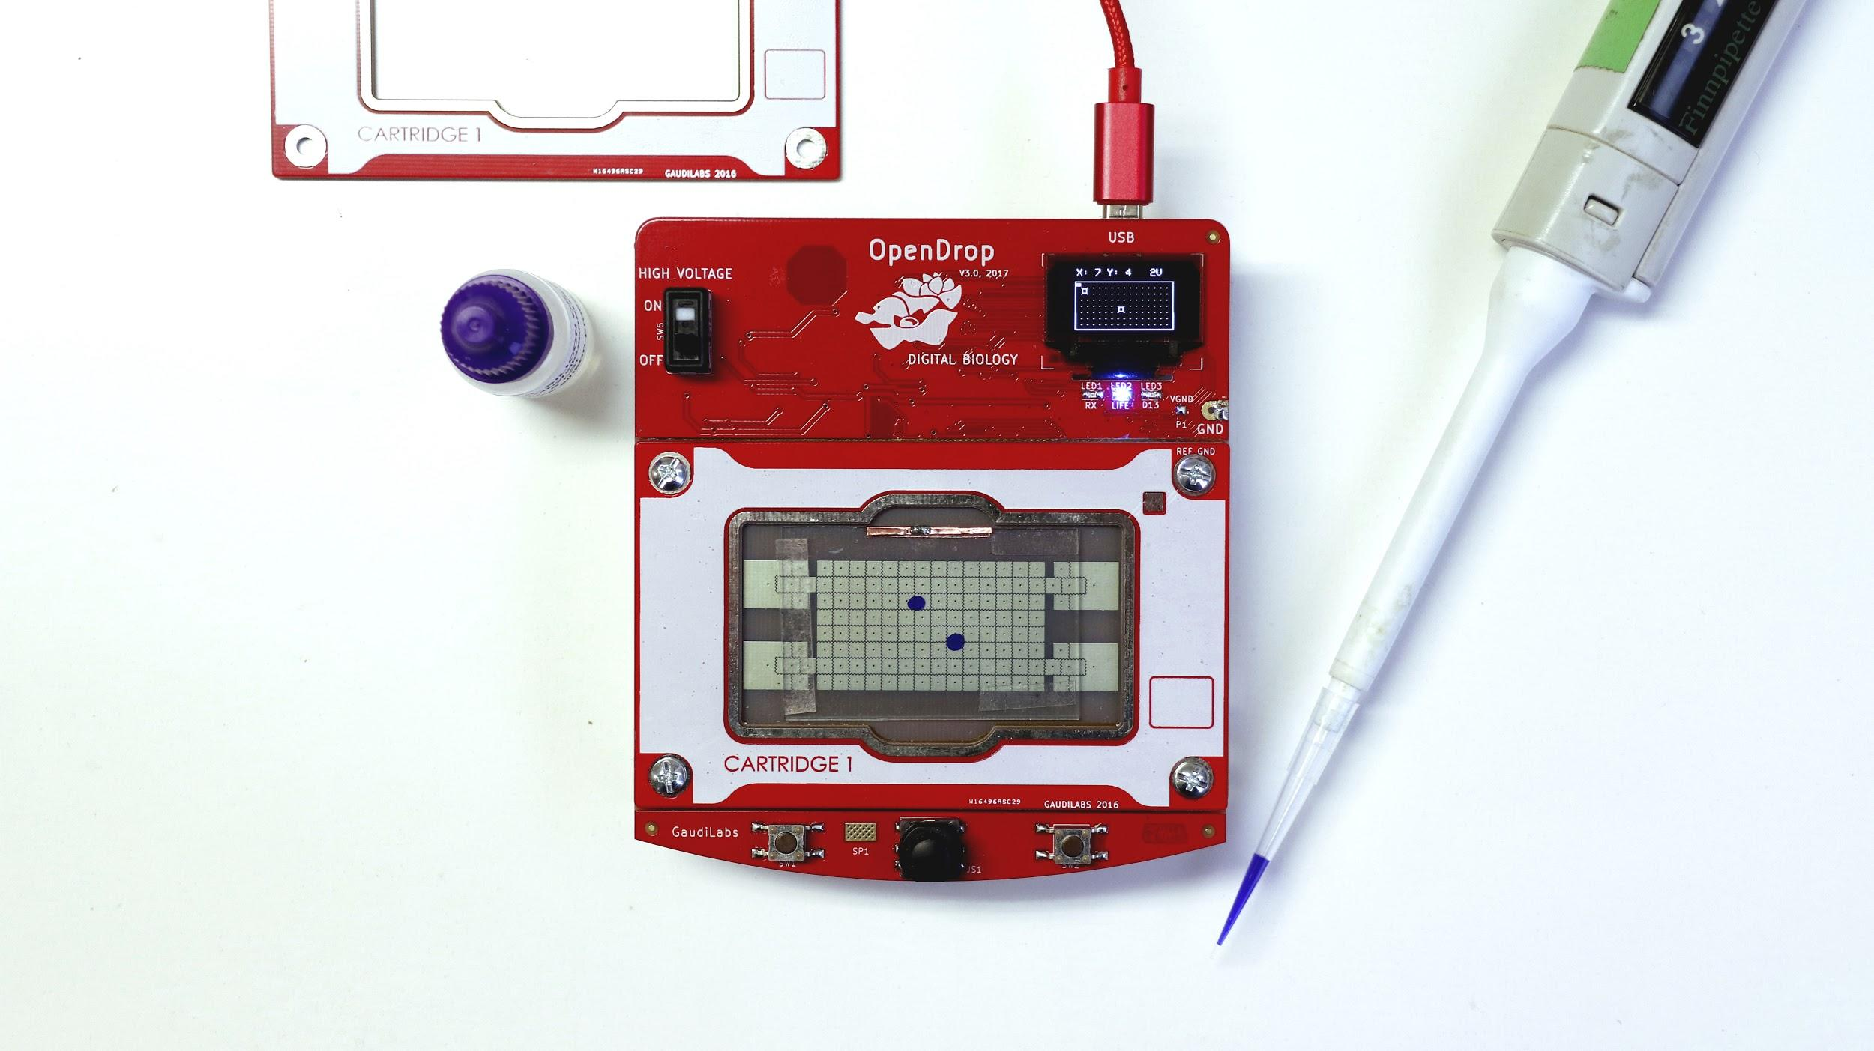

Slide 7
Why open hardware?
How to make hardware open
Global Open Science Hardware Community
What can you do?

Slide 8
“Open”
What
does
mean?

Slide 9


Slide 10

A piece of data
or content is
if anyone is free to
use, reuse, and redistribute it
subject only, at most, to the requirement to attribute
and/or share-alike.
opendefinition.org

Slide 11

Open source hardware is hardware whose design is made publicly available so that anyone can study, modify, distribute, make, and sell the design or hardware based on that design.
The hardware’s source, the design from which it is made, is available in the preferred format for making modifications to it. Ideally, open source hardware uses readily-available components and materials, standard processes, open infrastructure, unrestricted content, and open-source design tools to maximize the ability of individuals to make and use hardware.
Open source hardware gives people the freedom to control their technology while sharing knowledge and encouraging commerce through the open exchange of designs.

Slide 12
Why open hardware?
How to make hardware open
Global Open Science Hardware Community
What can you do?

Slide 13
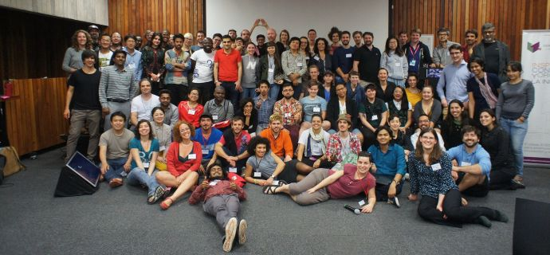


Slide 14
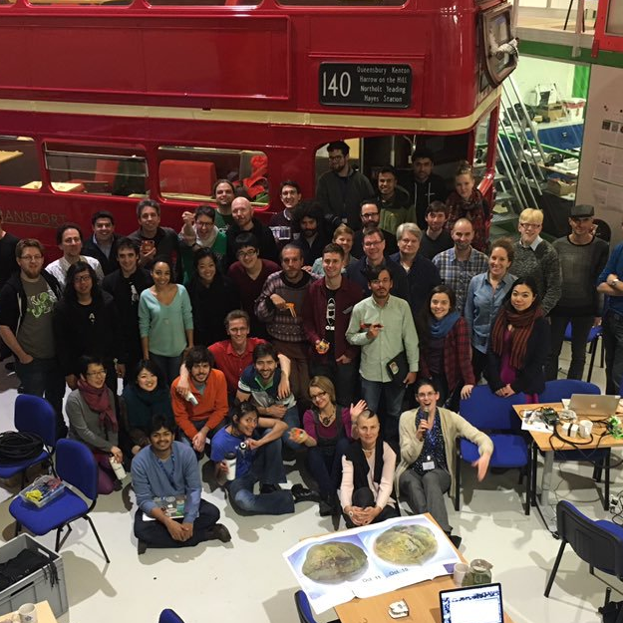
CERN, Switzerland
2016
GOSH…
changes the culture of science
democratizes science
has no high priests
empowers people
has no black boxes
is impactful tools
allows multiple futures for science
http://openhardware.science

Slide 15
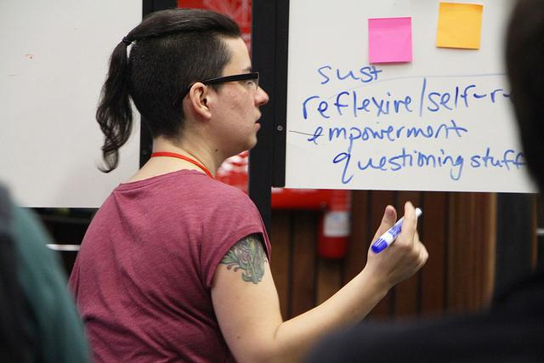
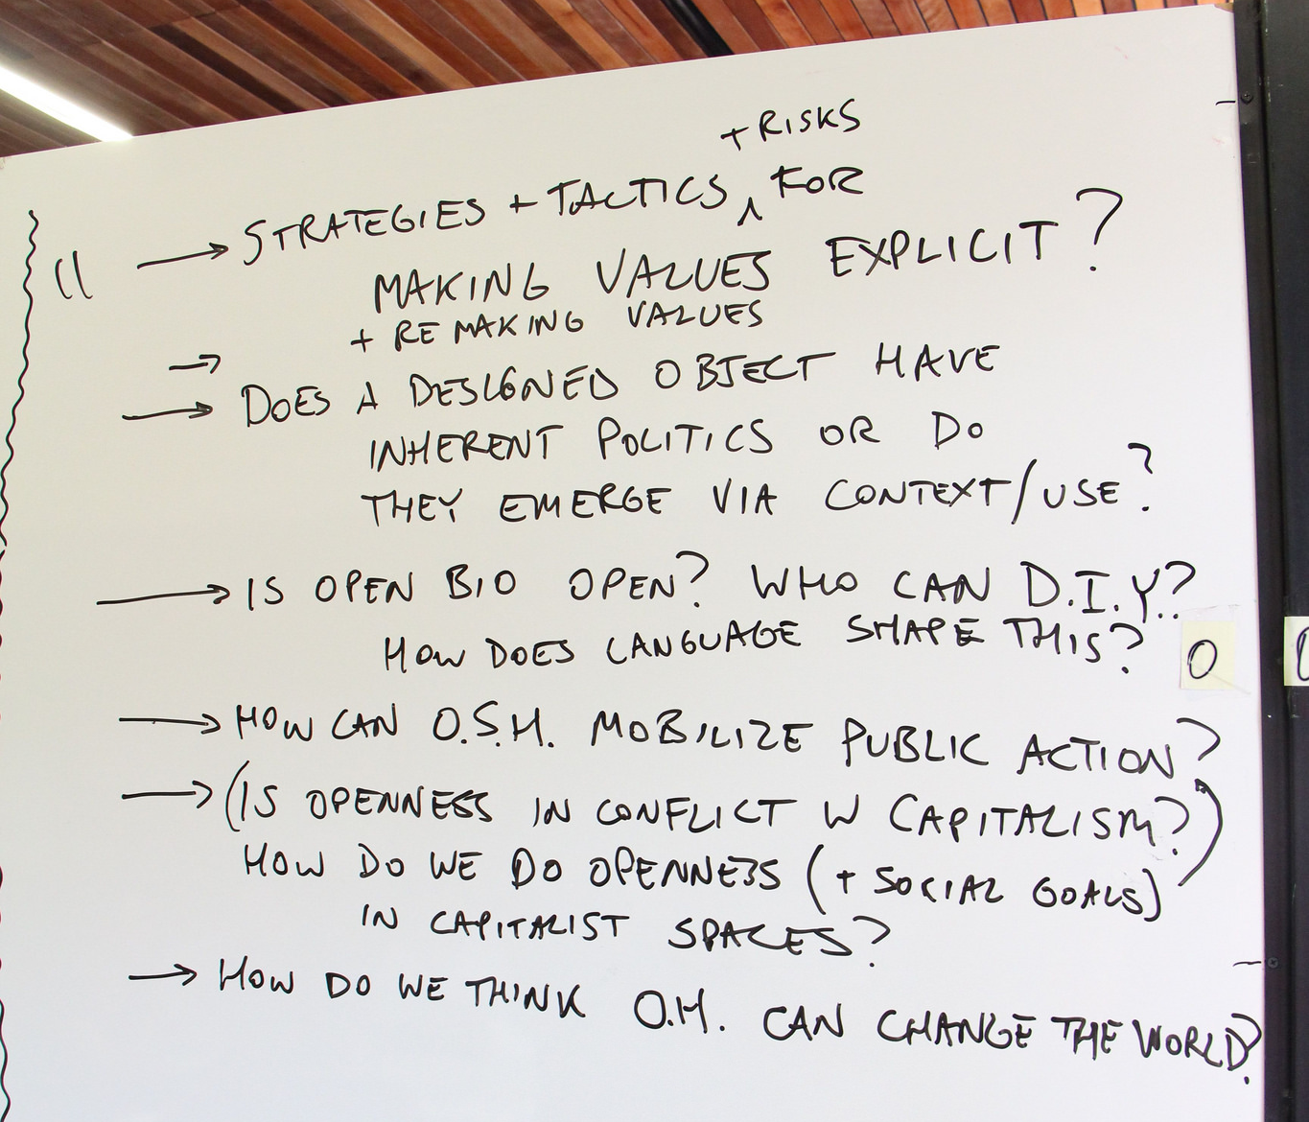
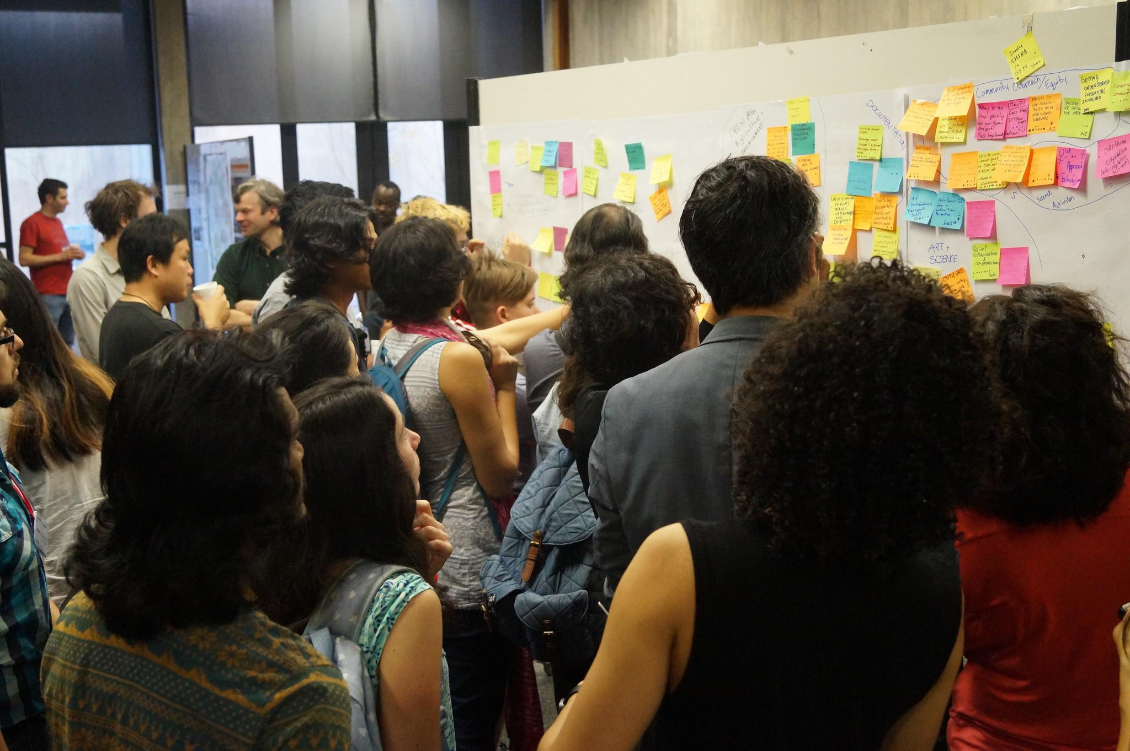
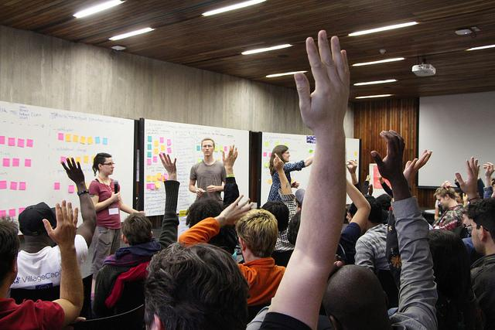

Slide 16

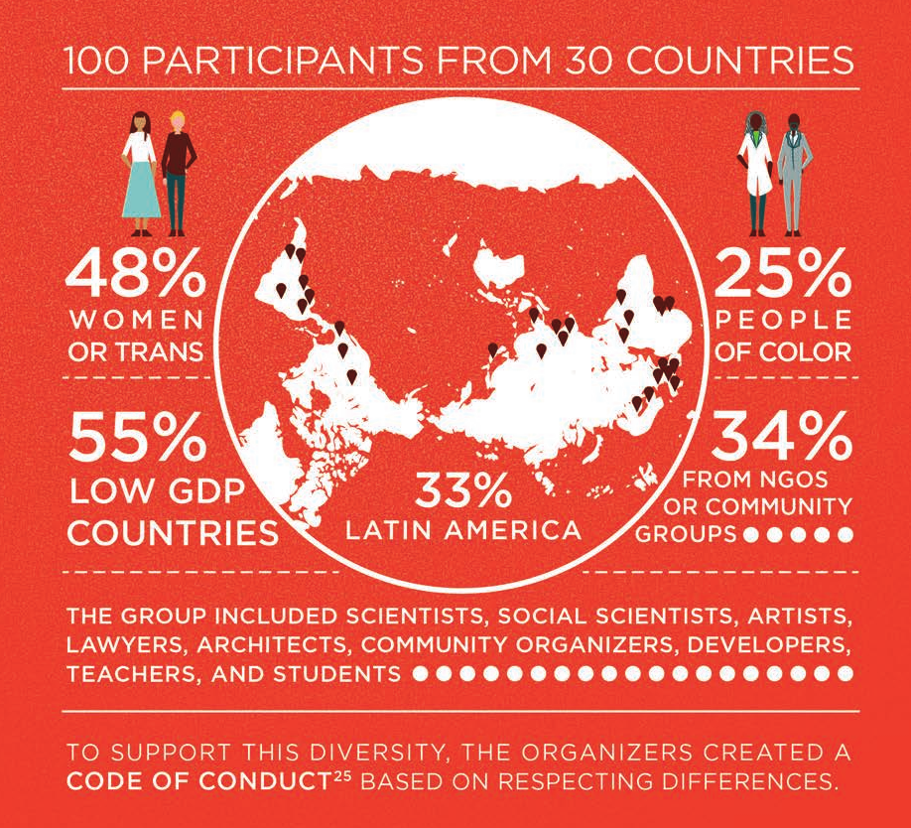

Slide 17


http://openhardware.science/global-open-science-hardware-roadmap/

Slide 18


learn about OScH, the contexts in which it currently operates, and the ways in which OScH impacts society.
Recommendations
Create a common research agenda with the OScH community.
Publish research findings!
Convene and collaborate to improve Open Hardware licensing and contracting strategies for OScH.
Produce better ways of Monitoring and Evaluation for OScH.

Slide 19
We will know we have created the necessary conditions to help our projects when we have:
A common pool of open educational resources, empirical Free and Open Source studies
Open Hardware documentation and licensing guidelines that are widely adopted

Slide 20


support individuals and forge partnerships to create the conditions under which OScH can
flourish.
Recommendations
Draft a comprehensive guide for public and philanthropic funders on supporting OScH development
Prepare and disseminate OScH documentation, testing and validation “best practices.”
Support the development of Free and Open Source tools for hardware design.
Provide training sessions and workshops to support current OScH projects.

Slide 21
This milestone will be reached when:
There is evidence of widespread institutional and community support for OscH
Institutional mandates and policy-level debates in support of Free and Open Source technologies will necessarily include Open Hardware for the sciences
Accessible and steady sources of funding for projects will also be available

Slide 22


grow with respect to local differences, increasing the diversity, scale and impact of the OScH community.
Recommendations
Global and regional meetings and online forums.
Design and implement mentorship programs and educational resources for OScH projects.
Advocate for OscH in policy and institutions.
Support the development of OScH distributor networks. Identify or develop resource sharing best practices for scaling up manufacturing and distribution.

Slide 23
This goal will be reached when equitable conditions are well-established for OScH development, dissemination, and use.

Slide 24
Why open hardware?
How to make hardware open
Global Open Science Hardware Community
What can you do?

Slide 25


Publish Open Hardware!

Slide 26
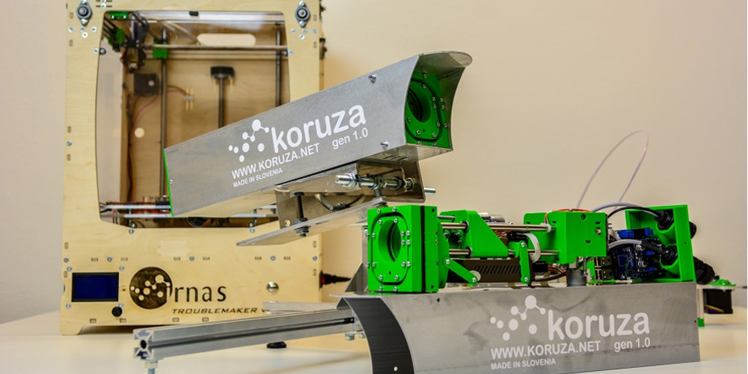



Document, document, document...
Hackaday.io, GitHub, Thingiverse, OshPark Shared Projects, Wordpress and other Blogs

Slide 27

Join communities

Slide 28


Slide 29

VISIT HTTP://OPENHARDWARE.SCIENCE
This presentation and all original content is licensed under CC-BY 4.0
- Created by Jenny Molloy 2018
- Adapted by Kaspar Emanuel 2018
Credited images below remain under the license used by the creator, including derivative images such as crops and recolourised versions produced for this presentation.
Image Credits:
All Gathering for Open Science Hardware images (Slides 9-14) are in the public domain under a CCZero waiver
Sharing what we create photo by Ed Yourdon under CC-BY-NC-SA. Slide by Cameron Neylon
Open sign by Todd Huffman on Flickr, licensed under CC-BY 2.0
Lego scientist by Clement127 on Flickr, licensed under CC-BY-NC-ND 2.0
OpenQCM image courtesy of GOSH, in the public domain under a CCZero waiver
Gel box and hardware equipment by Tobey Wenzel, licensed under CC-BY 4.0
OpenQCM image courtesy of GOSH, in the public domain under a CCZero waiver
IRNAS Koriza system by Jure Zagoranski
GOSH 2018 poster by Ji Li, Tsinghua University
Acknowledgements to Cameron Neylon for the “What is...?” slide design, his originals are licensed under CC-BY-SA

